Slide 1





How to have your cake and eat it too:
High-Productivity and High-Performance on Multicores
Ruston, 26 January 2011
CTCA group
Sven-Bodo Scholz
ADVANCE

Slide 2
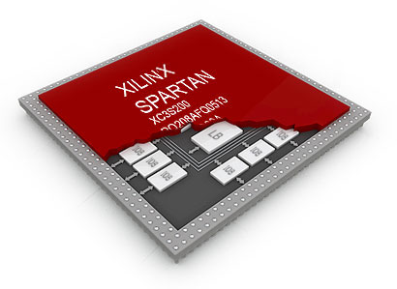
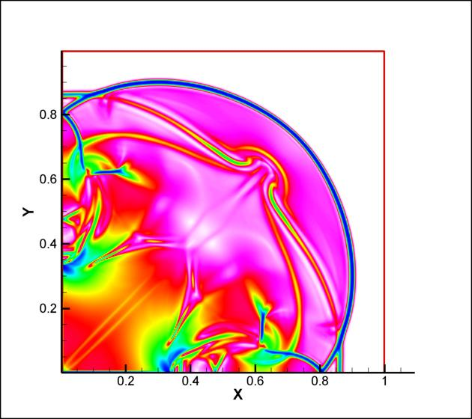
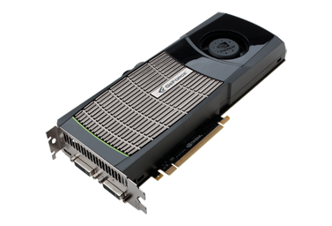

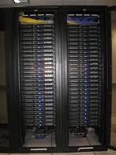
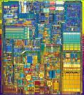
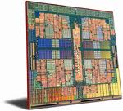

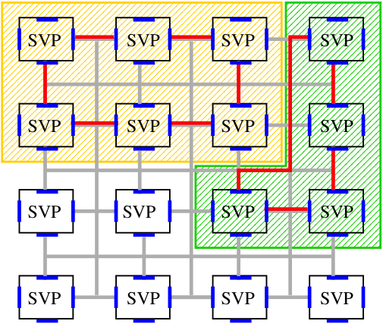
The Multi-Core Challenge
?????

Slide 3
Typical Workflow
☹
Handel-C
μTC
CUDA/
OpenCL
MPI/
OpenMP
algorithm

Slide 4
The High-Productivity Vision
☺
algorithm

Slide 5
How Can this Dream Come True?

Slide 6
SaC: HP² Driven Language Design
High-Productivity
easy to learn
  C-like look and feel
easy to program
  Matlab-like style
  OO-like power
  FP-like abstractions
easy to integrate
  light-weight C interface
High-Performance
no frills
  lean language core
performance focus
  strictly controlled side-effects
  implicit memory management
concurrency apt
  data-parallelism at core
&

Slide 7
A Taste of SaC
sqrt( sum( square( A)))
L2 norm:
Convolution step:
Convergence test:
W1 * shift(-1, A) + W2 * A + W1 * shift( 1, A)
all( abs( A-B) < eps)

Slide 8

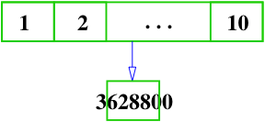
What is Data-Parallelism?
Formulate algorithms in space rather than time!
prod = prod( iota( 10)+1)
prod = 1;
for( i=1; i<=10; i++) {
prod = prod*i;
}

Slide 9
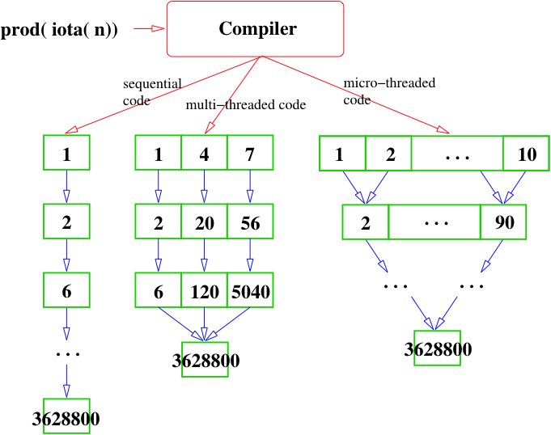
Why is Space Better than Time?

Slide 10
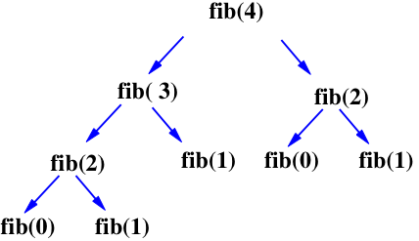
Another Example: Fibonacci Numbers
if( n<=1)
return n;
} else {
return fib( n-1) + fib( n-2);
}

Slide 11
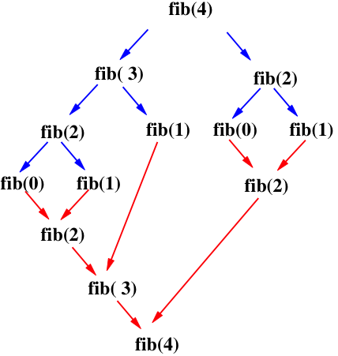
Another Example: Fibonacci Numbers
if( n<=1)
return n;
} else {
return fib( n-1) + fib( n-2);
}

Slide 12
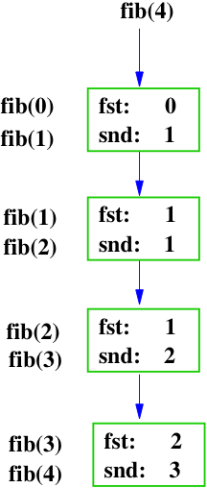
Fibonacci Numbers – now linearised!
if( n== 0)
return fst;
else
return fib( snd, fst+snd, n-1)

Slide 13
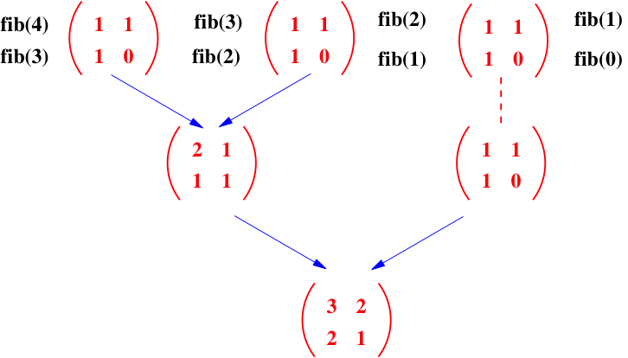
Fibonacci Numbers – now data-parallel!
matprod( genarray( [n], [[1, 1], [1, 0]])) [0,0]

Slide 14

The Single Assignment C Reality
☺
algorithm
SaC

Slide 15
From a Recent Paper Review:
”
To call the process of identifying SAC WITH-loops that can be executed in parallel in
CUDA "auto-parallelization" certainly stretches the definition of auto-parallelization (AP).
Traditionally AP refers to the process of converting a program written with the full
expressivity of an imperative language such as C or Fortran into a parallel version.
“
anonymous reviewer, LCPC 2010

Slide 16
The Yin and Yang of Concurrency
parallel execution
sequential execution

Slide 17
Multi-Threaded Execution on SMPs
data parallel operation

Slide 18
Looking at Entire Programs:

Slide 19
SMP Ideal: Coarse Grain!

Slide 20
SMP Measures
program transformation:
  fusion of data-independent operations
  fusion of data-dependent operations
  fusion of nested operations
sequential execution of:
  small index spaces
  inner operations

Slide 21
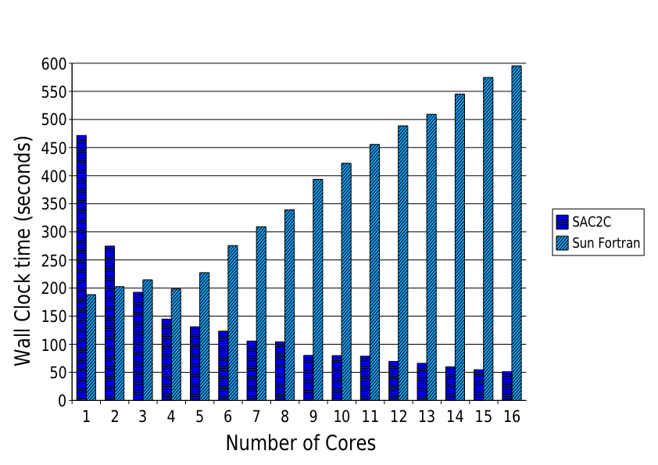
Some SMP Results: Shockwave Simulations

Slide 22
Further Surprises...
... From Your Memory System
Core
Core
Core
Core
Core
Core
Core
Core
Cache
Cache
Main Memory

Slide 23
SMP Memory Measures
program transformation:
  context-specific storage techniques
  extended memory re-use
  localisation of computations
runtime system:
  SaC-specific heap manager

Slide 24
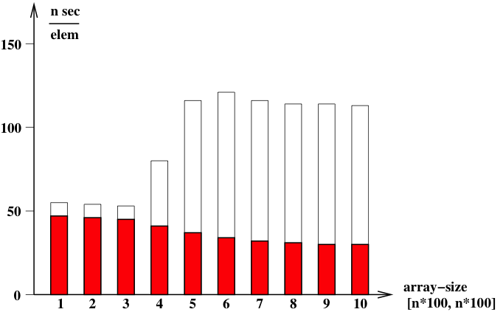
The Impact of Caches –
Column-wise operations
sophisticated order
naive order

Slide 25
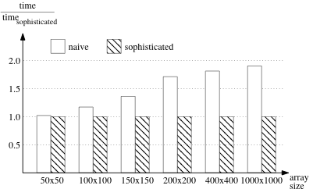
The Impact of Caches – coarse to fine mapping

Slide 26
Lessons Learnt:
concurrency
extensive program analyses
extensive program transformations
smart memory management
effective parallelism

Slide 27
GPGPU – Example Architecture
main memory
Host
CPU

Slide 28
Multi-Threaded Execution on GPGPUs
data parallel operation

Slide 29
GPGPU Ideal: Homogeneous Flat Coarse Grain

Slide 30
GPGPU Basic Measures
program transformation:
  fusion of data-independent operations
  fusion of data-dependent operations
  fusion of nested operations
sequential execution of:
  inner operations
  too complex operations (Ioops/ funs)

Slide 31
First Performance Figures on GPGPUs --- the impact of synchronous memory transfers

Slide 32
GPGPU Memory Measures
program transformation:
  transfer minimisation
  transfer reordering
  redundant computations
  transfer/ computation overlap

Slide 33
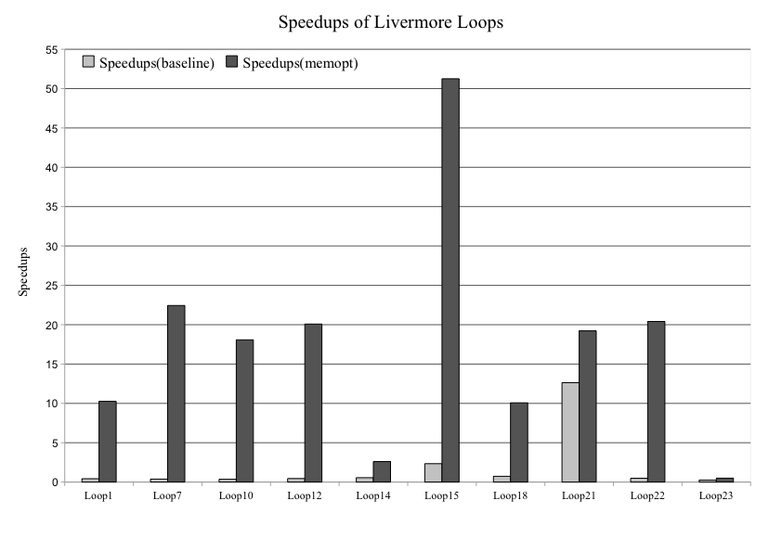
The Impact of Redundant Memory Transfers

Slide 34
Lessons Learnt:
can be extremely effective !
other concurrency selected !
memory transfers are crucial !
Hybrid SMP/GPGPU would be interesting!

Slide 35
The Microgrid Architecture

Slide 36
Multi-Threaded Execution on the Microgrid
data parallel operation

Slide 37
MicroGrid Expected Ideal: Full Concurrency !

Slide 38
MicroGrid Basic Measures
program transformations:
  fusion for better resource utilisation
  flattening of index spaces
sequential execution of:
  tiny index spaces
  mid-layer concurrency

Slide 39
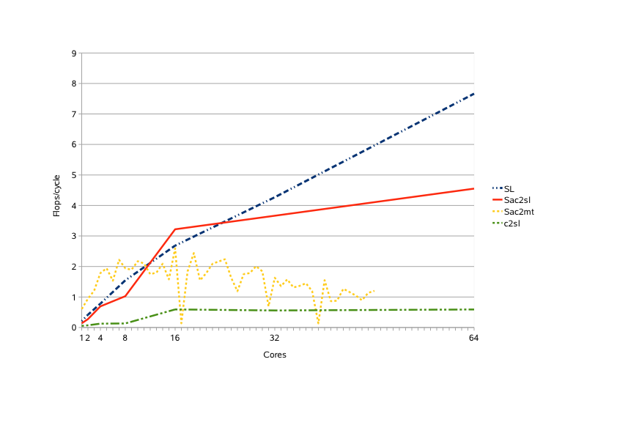
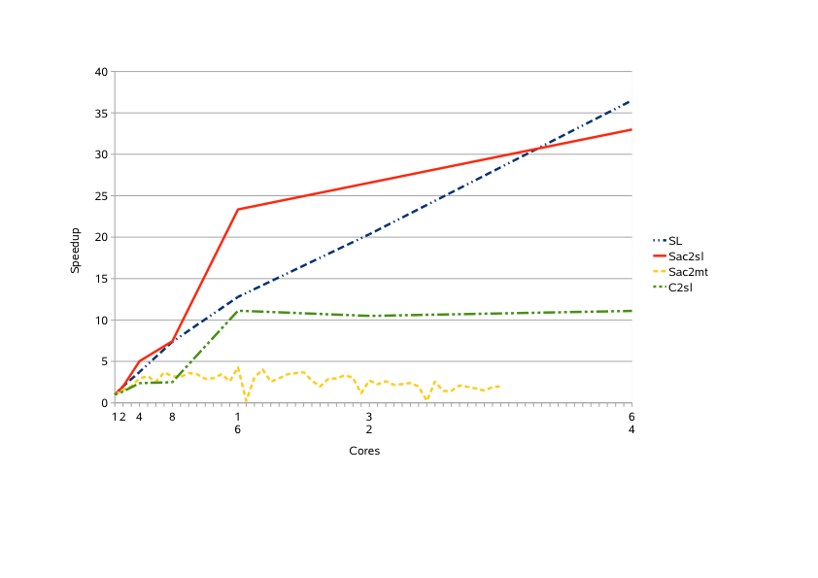
Smoothing a 100x100 Pixel Image on the Microgrid

Slide 40
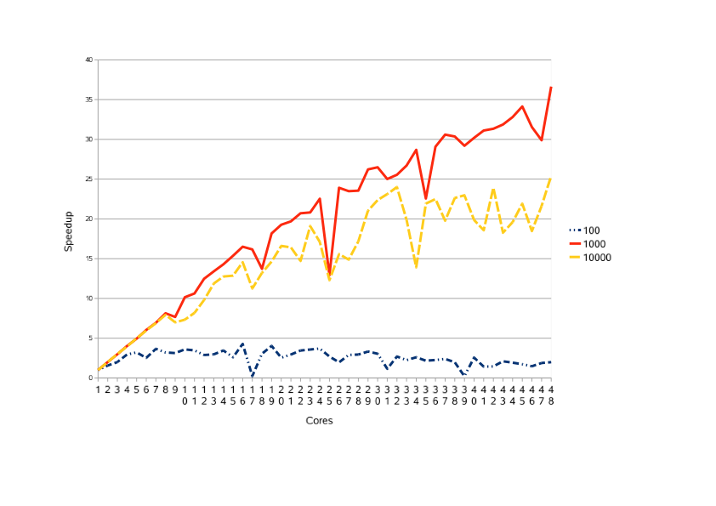
Smoothing Bigger Images on a 48-core Opteron
23 flops/cycle
0.7 flops/cycle

Slide 41
MicroGrid Memory Measures
program transformations:
  locality improvement by sequentialisation!
SaC runtime system:
  different reference counting strategy
  yet a new heap manager

Slide 42
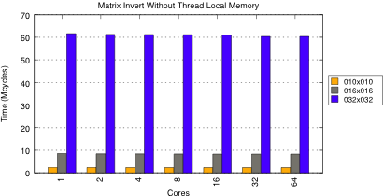
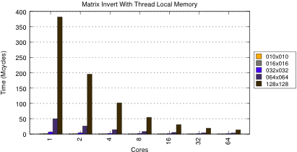
The Impact of Global Allocations

Slide 43
Lessons Learnt:
scales on much finer granularity!
still some concurrency throttling required
memory handling becomes even more crucial
static analyses can help a lot!

Slide 44
Conclusions
An effective parallel execution requires:
target-specific program transformations
target-specific program sequentialisation
aggressive program analyses
careful (!) code generation
parallel execution
try it out: www.sac-home.org
sequential execution

Slide 45
Future Developments:
Ongoing Work:
  utilisation of task concurrency
  vector instruction support
  out-of-core support
  massive concurrency on Intel’s SCC
Next Big Challenges:
  hybrid systems
  dynamic adaptivity
  amorphous data parallelism
  fault tolerance
stay tuned: www.sac-home.org

